Slide 1


Developing Ethical Standards for Life Science Researchers: Creation of the Tianjin Biosecurity Guidelines for Codes of Conduct for Scientists

Slide 2
What are the Tianjin Biosecurity Guidelines?
A set of 10 principles and standards of conduct designed to promote responsible science and strengthen biosecurity governance
Applicable across national, institutional, and industrial settings
A product of the InterAcademy Partnership, the Johns Hopkins Center for Health Security, and the Tianjin Centre for Biosafety Research and Strategy

Slide 3
Why have the Tianjin Biosecurity Guidelines?
Lack of a commonly accepted set of guiding principles for international biosecurity practices.
Rapid advances in biological sciences has expanded the need for norms that promote responsible research.
We need codes of conduct for biological scientists that support the great diversity of biological science conducted across disciplines.
The Guidelines provide a foundation for responsible conduct in the life sciences at the global level.

Slide 4

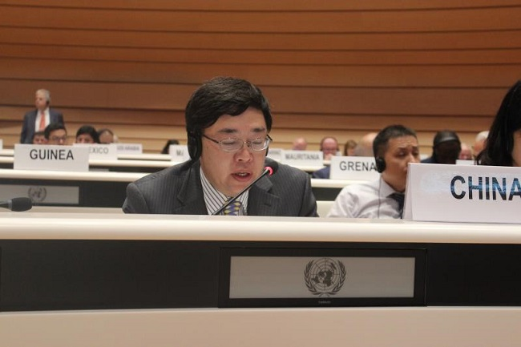
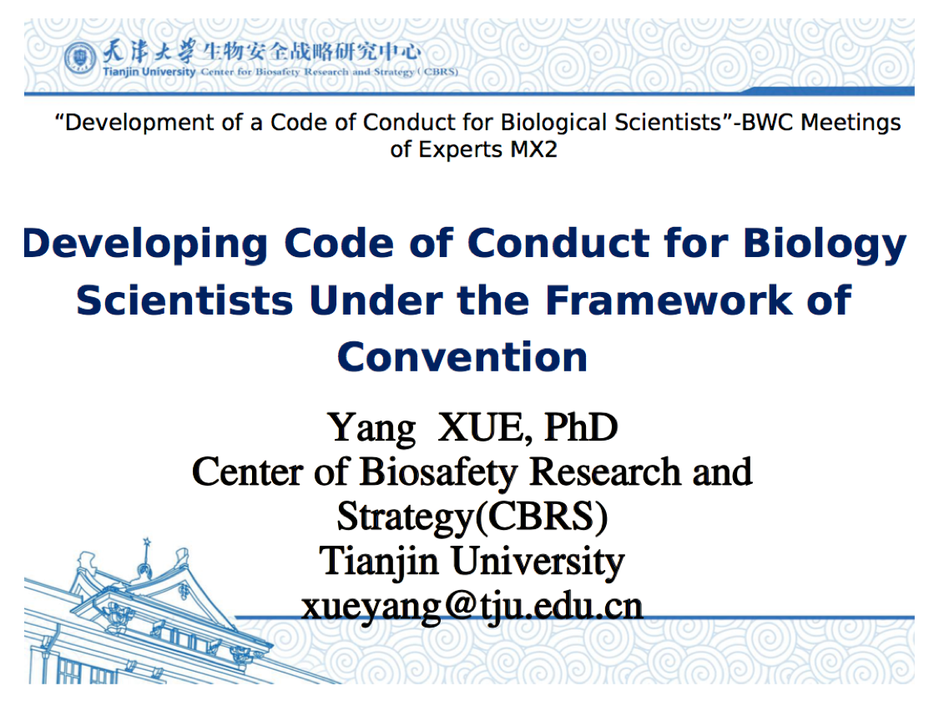
Inspiration
3 documents provided inspiration for the Tianjin Biosecurity Guidelines
In 2015, China and Pakistan proposed a draft code of conduct to the Biological and Toxin Weapons Convention (BWC).
The Hague Ethical Guidelines are a widely recognized set of ethical standards aimed to increase safety and security among chemistry practitioners.
The InterAcademy partnership published the “Statement on Biosecurity” in 2005, it received endorsement from over 60 national academies of science.
2018 Int’l Workshop in Tianjin
2018 BWC MX2

Slide 5
The Tianjin Biosecurity Guidelines for Codes of Conduct for Scientists
“
Preamble: Advances in the biological sciences bring about wellbeing for humanity, but the same advances could be misused, particularly for the development and proliferation of biological weapons. To promote a culture of responsibility and guard against such misuse, all scientists, research institutions, and governments are encouraged to incorporate elements from the Tianjin Biosecurity Guidelines for Codes of Conduct for Scientists in their national and institutional practices, protocols, and regulations. The ultimate aim is to prevent misuse of bioscience research without hindering beneficial outcomes, in accordance with the articles and norms of the Biological and Toxin Weapons Convention (BWC), and in advancement of progress towards achieving the UN Sustainable Development Goals.
For purposes of this document, “scientists” are practitioners engaged in work that includes biological science, including those involved in funding, education, and training; research and development (in the public and private sectors); project planning, management, dissemination, and oversight.
”

Slide 6



The Tianjin Biosecurity Guidelines for Codes of Conduct for Scientists
Ethical Standards: Scientists should respect human life and relevant social ethics. They have a special responsibility to use biosciences for peaceful purposes that benefit humankind, to promote a culture of responsible conduct in biosciences and to guard against the misuse of science for malicious purposes, including harm to the environment.
Laws and Norms: Scientists should be aware of and observe applicable domestic laws and regulations, international legal instruments, and norms relating to biological research, including those on the prohibition of biological weapons. Scientists and their professional bodies are encouraged to contribute to the establishment and further development and strengthening of relevant legislation
Responsible Conduct of Research: Scientists should promote scientific integrity and strive to prevent misconduct in research. They should be aware of the multiple applications of biological sciences, including their potential use for developing biological weapons. Measures should be taken to prevent the misuse and negative impacts of biological products, data, expertise, or equipment.

Slide 7



The Tianjin Biosecurity Guidelines for Codes of Conduct for Scientists
Respect for Research Participants: Scientists have a responsibility to protect the welfare of both human and non-human research participants and to apply the highest ethical standards in research conduct, with full respect for the subjects of research.
Research Process Management: Scientists should identify and manage potential risks when they pursue the benefits of biological research and processes. They should consider potential biosecurity concerns at all stages of scientific research. Scientists and scientific institutions should put in place oversight mechanisms and operational rules to prevent, mitigate, and respond to risks, and establish a culture of safety and security.
Education and Training: Scientists, along with their professional associations in industry and academia , should work to maintain a well-educated, fully trained scientific community that is well versed in relevant laws, regulations, international obligations and norms. Education and training of staff at all levels should consider the input of experts from multiple fields, including social and human sciences, to provide a more robust understanding of the implications of biological research. Scientists should receive ethical training on a regular basis.

Slide 8


The Tianjin Biosecurity Guidelines for Codes of Conduct for Scientists
Research Findings Dissemination: Scientists should be aware of potential biosecurity risks that might result from deliberate misuse of their research. Scientists and scientific journals should strike a balance when disseminating research findings between maximizing benefits and minimizing harm and communicate widely the beneficial aspects of research while minimizing potential risks that could result from such publication.
Public Engagement on Science and Technology: Scientists and scientific organizations should play an active role in encouraging public understanding and interest in biological science and technology, including its potential benefits and risks. They should communicate scientific facts and address concerns, uncertainties and misunderstandings to maintain public trust. Scientists should advocate for peaceful and ethical applications of the biosciences and work collectively to prevent misuse of biological knowledge, tools, and technologies.

Slide 9


The Tianjin Biosecurity Guidelines for Codes of Conduct for Scientists
Role of Institutions: Scientific institutions, including research, funding, and regulatory bodies, should be aware of the potential for misuse of bioscience research, and ensure that expertise, equipment, and facilities are not used for illegal, harmful, or malicious purposes at any stage of bioscience work. They should establish appropriate mechanisms and processes to monitor, assess, and mitigate potential vulnerabilities and risks in scientific activities and dissemination, and establish a training system for scientists. The Tianjin Biosecurity Guidelines for Codes of Conduct for Scientists
International Cooperation: Scientists and scientific institutions are encouraged to cooperate internationally and to collaborate in the pursuit of peaceful innovations in and applications of the biosciences. They should promote learning and exchange opportunities to share best practices in biosecurity. They are encouraged to actively provide relevant expertise and assistance in response to potential biosecurity threats.

Slide 10
Development Process
10 Articles of the Guidelines | Operational Category
1. Ethical Standards | Scientists’ general responsibilities
2. Laws and Norms
3. Responsible Conduct of Research | Scientists’ specific responsibilities in the entire process of their research
4. Respect for Research Participants
5. Research Progress Management
6. Education and Training
7. Research Findings Dissemination
8. Public Engagement on Science and Technology
9. Role of Institutions | Responsibilities of relevant institutions
10. International Cooperation
Representatives from the 3 organizations developed draft iterations of the Tianjin Biosecurity Guidelines in early 2021
April 8, 2021: Organizers co-hosted a virtual meeting of 21 biological scientists and experts on effective governance of scientific research from 15 countries across 5 continents.
  Participants submitted written feedback.
  Workshop focused on foundational elements of the Guidelines.
May 26, 2021: Workshop participants reconvened to agree on the Tianjin Biosecurity Guidelines.

Slide 11
Finalization
Finalized in June 2021.
Received an official endorsement from the InterAcademy Partnership following review by members of its Statements Governance Committee in July 2021.
Available in six languages (Arabic, Chinese, English, French, Russian, and Spanish).
Shared through professional networks.
Dissemination activities have included presentations at the BWC Meeting of Experts in June 2021 and to leaders at the International Union of Biochemistry and Molecular Biology

Slide 12
Questions and Comments

